Slide 1

A
Presentation on
“VeriFace — Verify the Media. Reveal the Truth.”
By
Tanishq Nandwana
Divyanshu Kumbe
Yanshu Baria
Under the Guidance of
Dr. Varsha Nemade
Department of Computer Science
MPSTME, Shirpur Campus
2026-27

Slide 2
Outline
Objective of Project
  Literature Survey
  Problem Statement
  Proposed Solution
  Software and Hardware Requirements
  Project Development Timeline (Gantt Chart)
  References

Slide 3
Objective
To develop a unified AI platform to detect manipulated images, deepfake videos, and synthetic or cloned audio with explainable results.
To detect manipulated image, video and audio content through one unified AI platform.
To learn robust spatial, frequency, temporal, style-latent and audio features that generalize to unseen deepfake generators.
To identify suspicious regions, frames or audio segments and provide explainable confidence-based results.
To store analysis records, generate forensic reports and evaluate cross-dataset / cross-manipulation performance.

Slide 4
Literature Survey
Base Paper | Core Technique | Reported Result | Adoption in VeriFace | Research Gap | How VeriFace Overcomes It
Luo et al. (2025) – FA-ViT (Image) | ViT + GAM + LAM + FAL | 93.83% AUC on Celeb-DF, 78.32% on DFDC | Image forgery detection branch | Image detectors often overfit dataset-specific artifacts and struggle with unseen forgery methods. | Uses frozen ViT + global/local adapters + FFT features to learn more general forgery traces.
Choi et al. (CVPR 2024) – Style Latent Flows (Video) | pSp + StyleGRU + 3D ResNet + Style Attention + Transformer | 95.8% average cross-dataset AUC | Video temporal-analysis branch | Existing video detectors rely heavily on low-level temporal artifacts, which advanced deepfakes can suppress. | Analyzes style-latent changes between frames along with visual-temporal features for stronger detection.
Wu et al. (2024) – CLAD (Audio) | AASIST + MoCo Contrastive Learning + Length Loss | FAR ≤ 1.63% under tested manipulations | Audio deepfake detection branch | Audio detectors are vulnerable to noise, fading, volume changes, resampling, and other manipulations. | Uses contrastive learning, manipulation augmentation, and length loss to learn manipulation-robust audio features.

Slide 5
  Problem Statement
Existing deepfake detectors often support only one media type, provide limited explanations, and perform poorly on unseen or compressed data.
VeriFace aims to:
Detect real or manipulated media.
Locate suspicious regions, frames, or audio segments.
Improve performance on unseen manipulations.
Present clear results through a dashboard and forensic report.

Slide 6
Proposed Solution
Upload Media + Type Router
(Image / Video / Audio)
IMAGE BRANCH
VIDEO BRANCH
AUDIO BRANCH
Face detection & alignment
Frozen ViT-B/16
+ GAM / LAM adapters
+ FAL objective
+ FFT forensic cue
Output: image score + Grad-CAM
Sample 8-16 frames
pSp style latents -> Δ style flow
StyleGRU + 3D ResNet content
Style Attention + Temporal Transformer
Output: video/frame score + heatmap
Extract 16 kHz waveform
AASIST encoder
CLAD MoCo contrastive learning
+ length loss
+ manipulation augmentations
Output: audio score + segment saliency
Media-aware Late Fusion / Decision Logic
(Video can combine visual + audio confidence)
Final Verdict (Real / Manipulated) + Confidence + Region/Frame/Audio Explanation
PostgreSQL Case Log + Downloadable Forensic PDF Report

Slide 7
  Software and Hardware Requirements
Software
Operating System | Windows 10/11 or Ubuntu Linux
Programming Language | Python 3.x
Deep Learning Framework | PyTorch
Image/Video Processing | OpenCV, MTCNN
Audio Processing | Librosa / Torchaudio
Backend | FastAPI / Flask
Frontend | React.js
Database | PostgreSQL
Explainability | Grad-CAM
Deployment | Docker
Hardware
Processor | Intel Core i5/i7 or AMD Ryzen 5/7
RAM | Minimum 16 GB
GPU | NVIDIA GPU with 6–8 GB VRAM
Storage | Minimum 256 GB SSD
Internet | Stable broadband connection

Slide 8
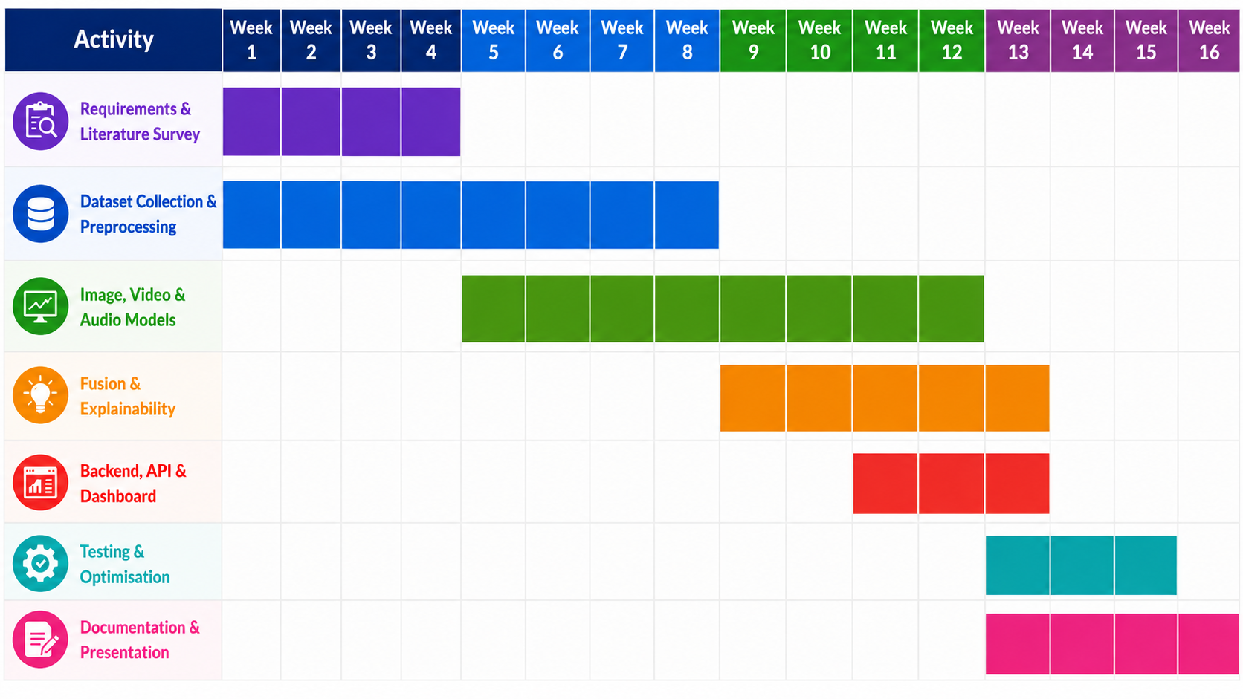
  Project Development Timeline (Gantt Chart)

Slide 9
References
A. Luo, R. Cai, C. Kong, Y. Ju, X. Kang, J. Huang, and A. C. Kot, “Forgery-Aware Adaptive Learning With Vision Transformer for Generalized Face Forgery Detection,” IEEE Transactions on Circuits and Systems for Video Technology, vol. 35, no. 5, 2025.
J. Choi, T. Kim, Y. Jeong, S. Baek, and J. Choi, “Exploiting Style Latent Flows for Generalizing Deepfake Video Detection,” IEEE/CVF Conference on Computer Vision and Pattern Recognition (CVPR), 2024.
H. Wu, J. Chen, R. Du, C. Wu, K. He, X. Shang, H. Ren, and G. Xu, “CLAD: Robust Audio Deepfake Detection Against Manipulation Attacks with Contrastive Learning,” arXiv preprint arXiv:2404.15854, 2024.
D. Nguyen, N. Mejri, I. P. Singh, P. Kuleshova, M. Astrid, A. Kacem, E. Ghorbel, and D. Aouada, “LAA-Net: Localized Artifact Attention Network for Quality-Agnostic and Generalizable Deepfake Detection,” IEEE/CVF Conference on Computer Vision and Pattern Recognition (CVPR), 2024.
A. Haliassos, K. Vougioukas, S. Petridis, and M. Pantic, “Lips Don’t Lie: A Generalisable and Robust Approach to Face Forgery Detection,” IEEE/CVF Conference on Computer Vision and Pattern Recognition (CVPR), 2021.
H. Zhao, W. Zhou, D. Chen, T. Wei, W. Zhang, and N. Yu, “Multi-attentional Deepfake Detection,” IEEE/CVF Conference on Computer Vision and Pattern Recognition (CVPR), 2021.
J. Jung, H.-S. Heo, H. Tak, H.-J. Shim, J. S. Chung, B.-J. Lee, H.-J. Yu, and N. Evans, “AASIST: Audio Anti-Spoofing Using Integrated Spectro-Temporal Graph Attention Networks,” IEEE International Conference on Acoustics, Speech and Signal Processing (ICASSP), 2022.

